Slide 1

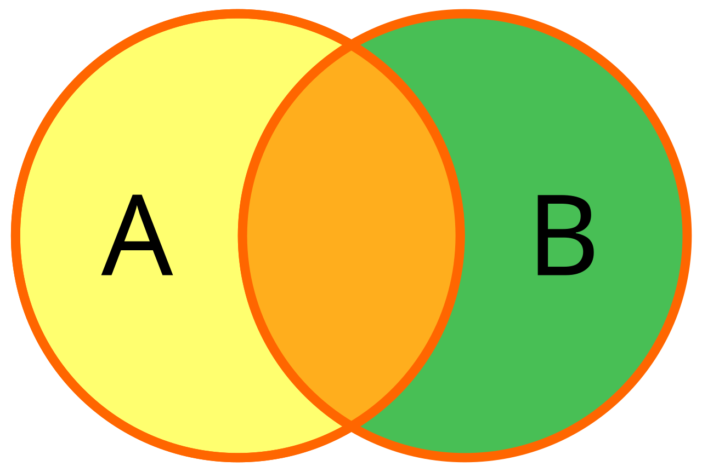
Advanced SQL Concepts
mintesnot

Slide 2
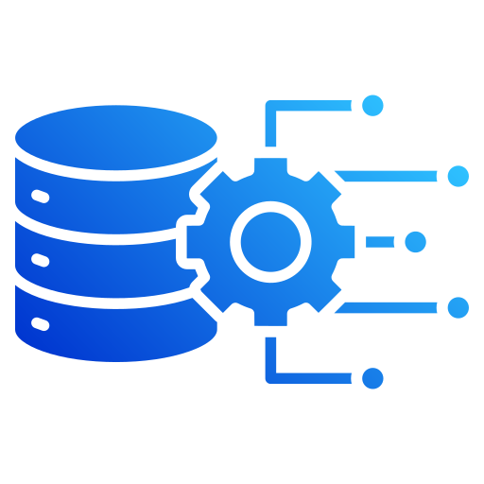
What is JOIN?
Unnormalized Form
First Normal Form
Second Normal Form
Third Normal Form
Boyce-Codd Normal Form
Fourth Normal Form
Fifth Normal Form
Sixth Normal Form
Cardinality
Types of Cardinality

Slide 3

What is a Join?
JOIN is used to combine data from two or more tables based on a related column.
They help in:
Retrieving connected data stored across multiple tables.
Matching records using common columns.
Improving data analysis by combining related information.
Creating meaningful result sets from separate tables.
SQL joins are categorized into different types based on how rows from two tables are matched and combined.

Slide 4
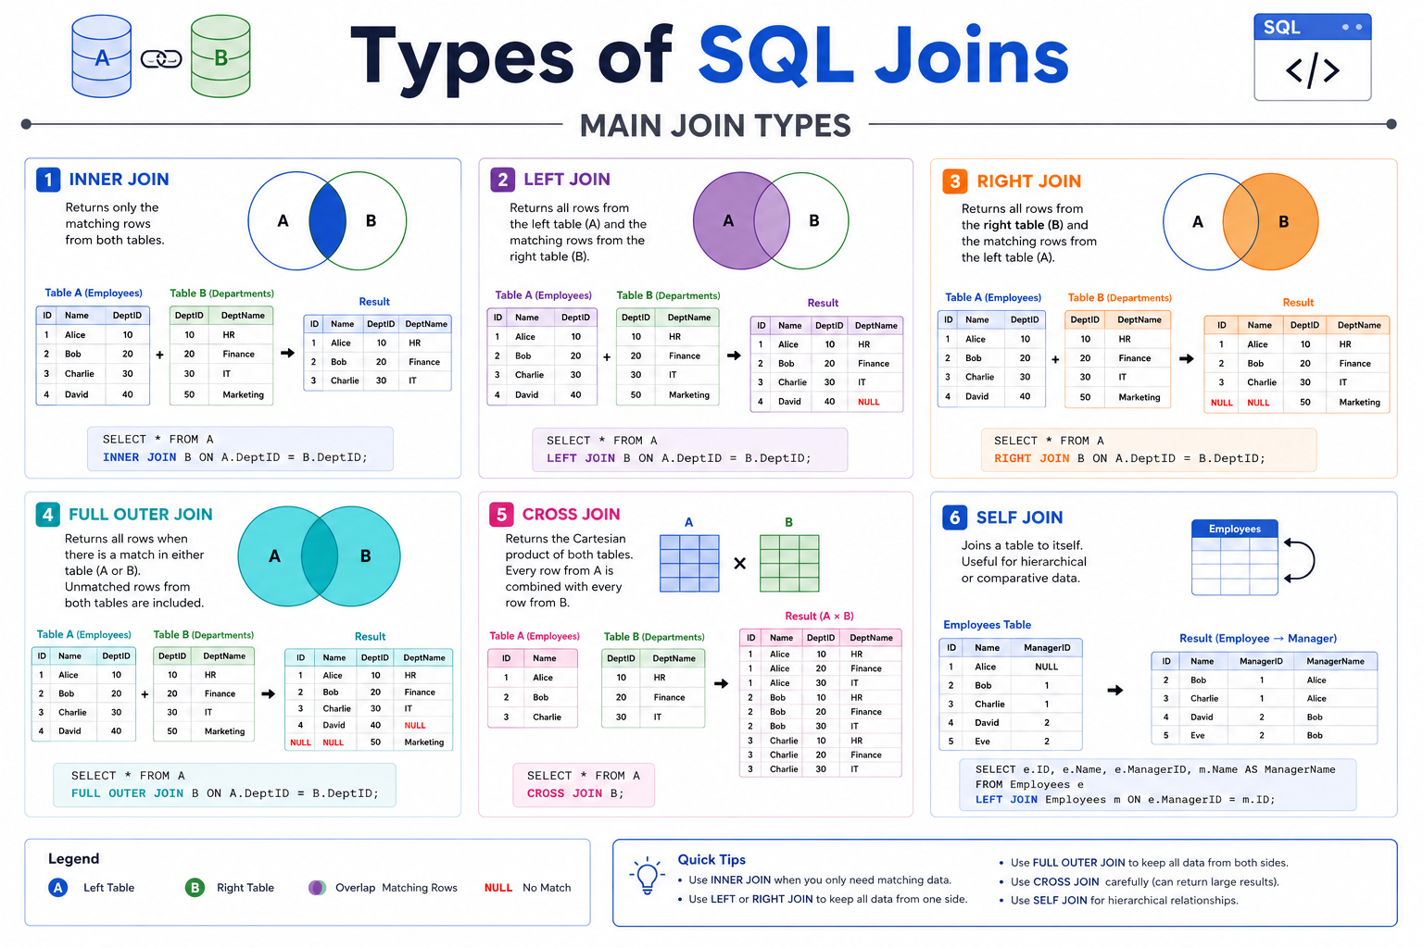
Types of SQL Joins
INNER JOIN
LEFT JOIN
RIGHT JOIN
FULL OUTER JOIN
CROSS JOIN
SELF JOIN

Slide 5
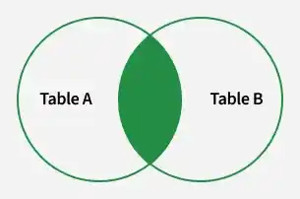

INNER JOIN
INNER JOIN is used to retrieve rows where matching values exist in both tables.
It helps in:
Combining records based on a related column.
Returning only matching rows from both tables.
Excluding non-matching data from the result set.
Ensuring accurate data relationships between tables.
SELECT table1.column1,table1.column2,table2.column1,.... FROM table1 INNER JOIN
table2 ON table1.matching_column = table2.matching_column;
Note: We can also write JOIN instead of INNER JOIN. JOIN is same as INNER JOIN.

Slide 6
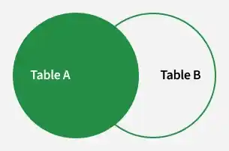
LEFT JOIN
LEFT JOIN is used to retrieve all rows from the left table and matching rows from the right table.
It helps in:
Returning all records from the left table.
Showing matching data from the right table.
Displaying NULL values where no match exists in the right table.
Performing outer joins, also known as LEFT OUTER JOIN.
SELECT table1.column1,table1.column2,table2.column1,....
FROM table1
LEFT JOIN table2
ON table1.matching_column = table2.matching_column;
Note: We can also use LEFT OUTER JOIN instead of LEFT JOIN, both are the same.

Slide 7
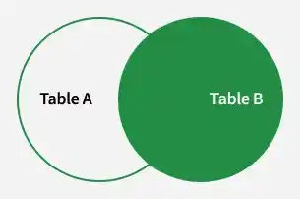
RIGHT JOIN
RIGHT JOIN is used to retrieve all rows from the right table and the matching rows from the left table.
It helps in:
Returning all records from the right-side table.
Showing matching data from the left-side table.
Displaying NULL values where no match exists in the left table.
Performing outer joins, also known as RIGHT OUTER JOIN.
SELECT table1.column1,table1.column2,table2.column1,....
FROM table1
RIGHT JOIN table2
ON table1.matching_column = table2.matching_column;
Note: We can also use RIGHT OUTER JOIN instead of RIGHT JOIN, both are the same

Slide 8
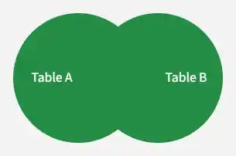
FULL JOIN
FULL JOIN is used to combine the results of both LEFT JOIN and RIGHT JOIN.
It helps in:
Returning all rows from both tables.
Showing matching records from each table.
Displaying NULL values where no match exists in either table.
Providing complete data from both sides of the join.
SELECT table1.column1,table1.column2,table2.column1,....
FROM table1
FULL JOIN table2
ON table1.matching_column = table2.matching_column;
Note: MySQL does not support FULL OUTER JOIN directly. It cab be simulated using UNION of LEFT JOIN and RIGHT JOIN.

